Slide 1



Slide 2
What we will cover today
Overview
Preprocessing
Compilation
Linking
Flashing
Questions
Notes:
We will de mystify the build process
Break it down in to steps
Explain what those steps do and what sort of errors they can vause

Slide 3
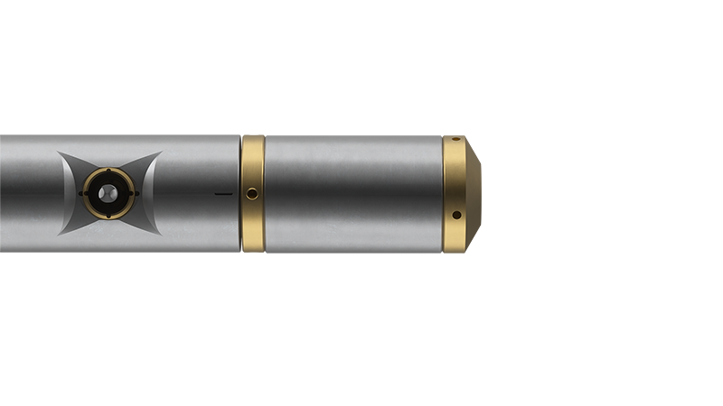
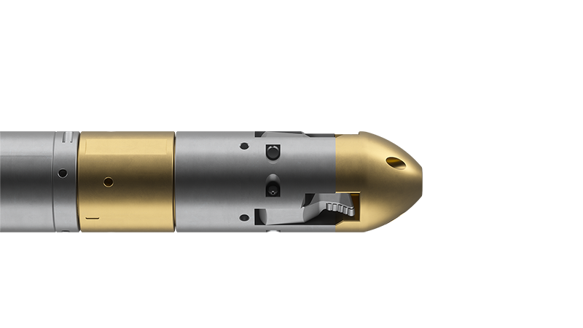
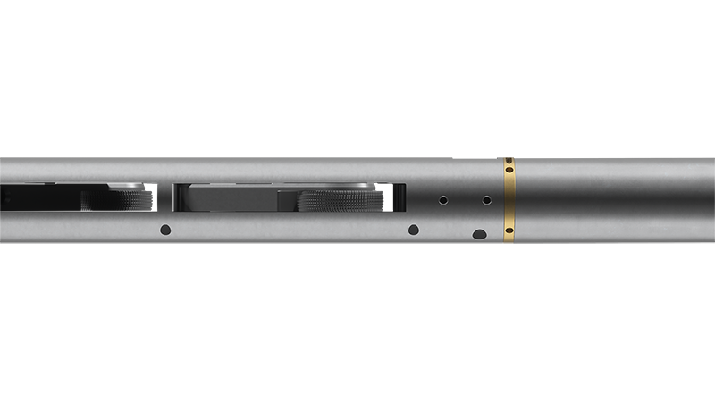
A word from my employer
Wells as thin as 5cm / 2”
Harsh environments; 185°C / 365°F,800 bar/ 11,000 PSI and pH values from 2.9 to 11.
Also, no sparks, please!
Develop everything in-house
Winds motors
Manufactures hydraulic valves, pumps and compressors
Embedded Linux
Baremetal / DSP
.NET/C#
RS-485, CAN, TCP/IP, RS-232, in-house modems and protocols.

Slide 4
Overview
Typing code
.cpp
.cpp
.cpp
.cpp
Preprocessing
.cpp
.cpp
.cpp
.cpp
Compiling
.i
.i
.i
.i
Linking
Libraries
.o
.o
Linker script
Libraries
Libraries
Flashing
Hexfile
Notes:
The result of the preprocessor is a “translation unit”
.o contains object code (machine code mixed with instructions to the linker)

Slide 5

Preprocessing
Include files
Resolve Macros
Removes comments
Resolves conditional compiling

Slide 6
Preprocessing – Include directive
$ g++ -E main.cpp
main.cpp
#include "class.h" int main(int argc,
char *argv[])
{
MyClass mc;
}
# 0 "main.cpp”
# 0 "<built-in>"
# 0 "<command-line>"
# 1 "/usr/include/stdc-predef.h" 1 3 4
# 0 "<command-line>" 2
# 1 "main.cpp"
# 1 "class.h" 1
class MyClass {};
# 2 "main.cpp" 2 int main(int argc, char *argv[])
{
MyClass mc;
}
class.h
class MyClass { };
Notes:
* INCLUDE *
1 Entering a new file
2 Returning to the previous file
3 System header (Suppress warnings and diagnostics originating from here)
4 C language linkage (e.g. extern "C")
# 0 "main.cpp" Marks the start of processing your main.cpp.
# 0 "<built-in>" Switches to compiler-provided built-in definitions.
# 0 "<command-line>" Switches to any macros or includes provided via the command line (like -D flags).
# 1 "/usr/include/stdc-predef.h" 1 3 4 Now we're in a real file, stdc-predef.h, at line 1. The flags here mean:
1: Entering a new file.
3: This is a system header.
4: This header is extern "C" by default.
# 0 "<command-line>" 2 Back to command-line context; 2 means leaving a file.
# 1 "main.cpp" Back to main.cpp.
# 1 "class.h" 1 Entering class.h.

Slide 7
Preprocessing – Include files
┌─ (0) morten@WT-PF4XHC0F:~
└─ $ cat main.cpp
#include <vector>
#include <stddef.h>
int main(int argc, char *argv[])
{
MyClass mc;
}
┌─ (0) morten@WT-PF4XHC0F:~
└─ $ g++ -E main.cpp | wc -l
19879
Notes:
Super sized files.

Slide 8
Preprocessing – Macro Expansion
#define POWER_OF_TWO( a ) (( a ) * ( a ))
int main(int argc, char *argv[])
{ int four = POWER_OF_TWO( 2 );
int nine = POWER_OF_TWO( 2 + 1 );
}
#define POWER_OF_TWO( a ) a * a
int main(int argc, char *argv[])
{ int four = POWER_OF_TWO( 2 );
int nine = POWER_OF_TWO( 2 + 1 );
}
$ g++ -E main.cpp | grep –v ”#”
$ g++ -E main.cpp | grep –v ”#”
int main(int argc, char *argv[])
{ int four = ( (2) * (2));
int nine = (( 2 + 1 ) * ( 2 + 1 ) );
}
int main(int argc, char *argv[])
{ int four = 2 * 2;
int nine = 2 + 1 * 2 + 1;
}
Notes:
INCLUDE
ANIMATION TIOL GOD LØSNIONG
This may not be an error you see during compilation and mayonly be visible at runtime

Slide 9

The 4⅛” grinder

Slide 10
Preprocessing – directives
#inlcude <iostreeam> int main()
{
std::cout << "Hello, world!\n";
return 0;
}
$ g++ main.cpp
main.cpp:1:2: error: invalid preprocessing directive #inlcude; did you mean #include?
1 | #inlcude <iostreeam>
| ^~~~~~~
Notes:
Super sized files.

Slide 11
Preprocessing – directives
#include <iostreeam> int main()
{
std::cout << "Hello, world!\n";
return 0;
}
$ g++ main.cpp
main.cpp:1:10: fatal error: iostreeam: No such file or directory
1 | #include <iostreeam>
| ^~~~~~~~~~~
Notes:
Super sized files.

Slide 12
Preprocessing – Macro Redifinitions
#define NAME "Morten"
#define NAME "Bjarne"
int main()
{
std::cout << "Hello, " << NAME << "!\n";
return 0;
}
$ g++ main.cpp
main.cpp:2: warning: "NAME" redefined
2 | #define NAME "Bjarne"
|
main.cpp:1: note: this is the location of the previous definition
1 | #define NAME "Morten"
Notes:
Super sized files.

Slide 13
Preprocessing – Summary
Typical messages:
"No such file or directory"
"Unknown preprocessing directive”
"Macro redefined"
How to fix:
Check include paths
Watch for typos
Avoid repeated includes
Notes:
We will get to include paths later

Slide 14


Slide 15







Side Quest – Error messages
main.cpp:1:10: fatal error: 'classes.h' file not found
1 | #include "classes.h"
| ^~~~~~~~~~~
1 error generated.
main.cpp:1:10: fatal error: classes.h: No such file or directory
1 | #include "classes.h"
| ^~~~~~~~~~~
compilation terminated.
main.cpp
<source>(1): fatal error C1083: Cannot open include file: classes.h': No such file or directory
Compiler returned: 2
Notes:
Rest of presentation will show gcc only.

Slide 16
Overview
Typing code
.cpp
.cpp
Preprocessing
.cpp
.cpp
Compiling
.i
.i
Linking
Libraries
.o
.o
Linker script
Libraries
Libraries
Flashing
Hexfile

Slide 17


Compilation
We do geothermal too…
Checks syntax
Checks semantics
Generates machine code
Probably most errors originates here

Slide 18
Compilation – Syntax and Semantics
int a = 17;
int b = 13; int c = a + / * b;
error: invalid type argument of unary ‘*’ (have ‘int’)
Notes:
The cat sleeps.
The cat reads books.
Works on TYPES and EXPRESSIONS and STATEMENTS

Slide 19
Compilation – Syntax and Semantics
class BucketOfPaint {};
class Horse {}; int main()
{
BucketOfPaint green;
Horse hidalgo;
int c = green + hidalgo;
}
main.cpp:9:19: error: no match for ‘operator+’ (operand types are ‘BucketOfPaint’ and ‘Horse’)
9 | int c = green + hidalgo;
| ~~~~~ ^ ~~~~~~~
| | |
| | Horse
| BucketOfPaint
Notes:
Acturlly you CAN make a bucket of npaint and a horse addable in C++, but that is another thing.

Slide 20
Compilation – Syntax and Semantics
int main() { int a = 17; int c = a + b; }
error: ‘b’ was not declared in this scope
4 | int c = a + b;
Notes:
Lets dwell a little on ”declared”

Slide 21
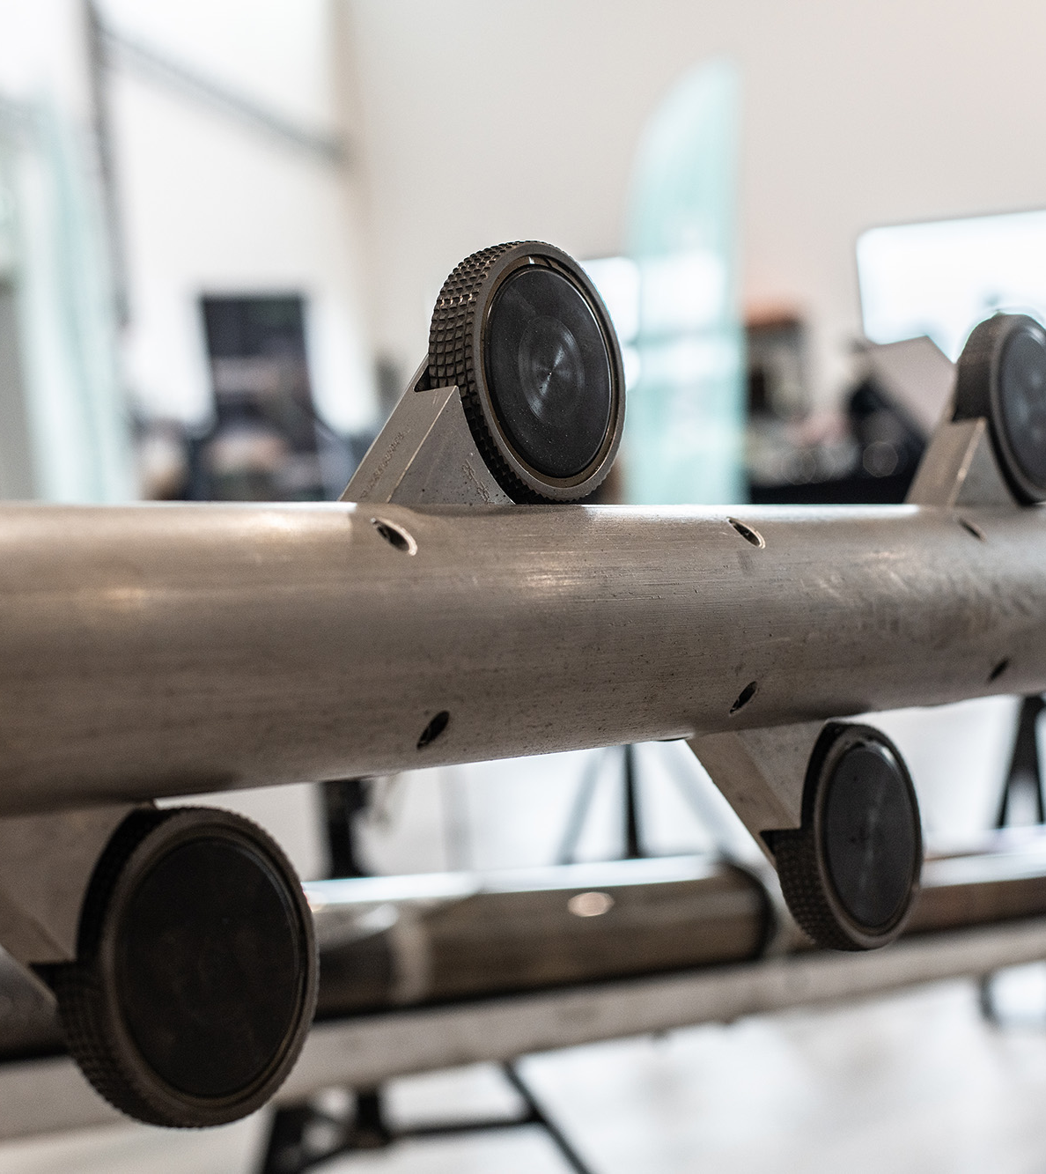
The 3⅛” tractor

Slide 22
Compilation – Definition and Declaration
Declaration
Definition
int addNumbers(int a, int b);
int addNumbers(int a, int b)
{
return a + b;
}
Dear compiler!
This function will be available later. And you can assume it exist.
I promise!
Dear compiler!
This is how int addNumbers(int a, int b) works.
Please create it and we might use it later
Notes:
The declaration is “the signature” of the function, class e.t.c.
What things are called becomes very important in the linking stage.

Slide 23
Compilation – Overview
expected ';' before '}' token | int x = 5 |  | assignment of read-only variable | const int x = 10; x = 5;
'x' was not declared in this scope | cout << x; |  | cannot bind non-const lvalue reference to an rvalue | void foo(int& x) {} foo(5);
no matching function for call to ‘foo(int, int)' | void foo(int a) {} foo(3, 4); |  | invalid operands of types 'int' and 'std::string' to binary 'operator+' | int x = 5; std::string s = "hello"; x + s;
error: cannot convert 'Horse' to 'int' | Horse h; foo(h);
Notes:
If your error is like, “this does not add up”, it is most likely compilation you have to consider.

Slide 24
Overview – What’s what?
#include <iostream>
#define PRINT(x) printf(X ”\n”);
int main()
{
if (true)
PRINT("Hello");
else
PRINT("World");
}
main.cpp:8: error: 'else' without a previous 'if'
main.cpp: In function 'int main()':
main.cpp:8:5: error: 'else' without a previous 'if'
8 | else
| ^~~~

Slide 25
Overview – What’s what?
#include <iostream>
#define PRINT(x) std::cout << x << std::endl;
int main()
{
if (true)
PRINT("Hello");
else
PRINT("World");
}
int main()
{
if (true)
std::cout << "Hello" << std::endl;; else
std::cout << "World" << std::endl;;
}

Slide 26
Compilation – Hieroglyphic Template Errors
main.cpp:22: error: request for member 'makeSound' in '((Stable<int>*)this)->Stable<int>::animal', which is of non-class type 'int’
main.cpp: In instantiation of 'void Stable<T>::listenTo() [with T = int]’:
main.cpp:22:27: required from here
main.cpp:12:16: error: request for member 'makeSound' in '((Stable<int>*)this)->Stable<int>::animal', which is of non-class type 'int'
12 | animal.makeSound();
| ~~~~~~~^~~~~~~~~
template <typename T>
class Stable {
public:
void listenTo() {
animal.makeSound();
} T animal;
}; int main() {
Stable<int> integerStable;
integerStable.listenTo();
return 0;
}
Notes:
Explain what this error is.
This is advanced C++ and while relevant probably out of scope.

Slide 27
Compilation - Errors
Errors about:
Expressions
Statements
Scopes
Types
It is
Code you typed
Code you can fix by typing your code differently

Slide 28
Overview
Typing code
.cpp
.cpp
Preprocessing
.cpp
.cpp
Compiling
.i
.i
Linking
Libraries
.o
.o
Linker script
Libraries
Libraries
Flashing
Hexfile

Slide 29

Linking
Takes all objects files
Takes all libraries
Merge them together
Conforms to the linker script
Creates a HEX file

Slide 30
Linking – Overview
int addNumbers(int a, int b) { return a + b; }
int main(int argc, char *argv[]) { ... }
int addNumbers(int a, int b) { return a + b;
int addNumbers(int a, int b) { return a + b; }
int main(int argc, char *argv[]) { ... }
…
Libraries provided by compiler
Libraries provided by chip vendor
Notes:
Takes your
own object code
Library code from the compiler
Library code from your chip vendor
And puts it in the correct place and order so it eventually fits in the chips memory

Slide 31
Linking - Regions
Memory space
0xFFDF
.
.TEXT
Flash
.TEXT: Compiled machine instructions
.CONST Read-only
.BSS: Global & static variables
.DATA: Global & static variables
.HEAP: Dynamically allocated memory
.STACK: Function calls, local variables
.CONST
.BSS
0xC000
.DATA
.HEAP
RAM
.STACK
0x0200
Notes:
.TEXT: Compiled machine instructions
.CONST Read-only data (constants, string literals)
BSS: Global & static variables (zero-initialized or unintialized)
.DATA: Global & static variables (initialized)
.HEAP: Dynamically allocated memory
.STACK: Function calls, local variables

Slide 32
Linking - Regions
MEMORY
{
FLASH (rx) : ORIGIN = 0x08000000, LENGTH = 256K
RAM (rwx) : ORIGIN = 0x20000000, LENGTH = 64K
}
SECTIONS
{
.text :
{
KEEP(*(.isr_vector)) /* Interrupt table */
*(.text*) /* Code */
*(.rodata*) /* Constants */
} > FLASH
.data :
{
*(.data*) /* Initialized globals */
} > RAM AT > FLASH /* Load in Flash, copy to RAM */
.bss :
{
*(.bss*) /* Zero-initialized data */
*(COMMON)
} > RAM
}

Slide 33
Linking – Common Errors
region FLASH overflowed by 1024 bytes | Your program is simply too large. Buy a larger chip, cut features or cut down on huge libraries as stdlib or language features like RTTI, exceptions and the standard library.
section .bss will not fit in region RAM | Modify your linker script to have .bss fit into RAM
multiple definition of _foo | int foo(int a, int b) { return a + b; } Exists in more than one file being linked in.
undefined reference to _foo | int foo(int a, int b) { return a + b; } Exists in no file being linked in.

Slide 34
Overview
Typing code
.cpp
.cpp
Preprocessing
.cpp
.cpp
Compiling
.i
.i
Linking
Libraries
.o
.o
Linker script
Libraries
Libraries
Flashing
Hexfile

Slide 35

Flashing
Moves the HEX file to target device.

Slide 36
Common Flashing errors
Cortex-M0
Error Output | Likely Cause
Error: unable to connect to target. No device found on SWD. | No SWD connection or target not powered.
Error: Failed to read IDCODE from target via SWD | Bad SWD wiring or incompatible device.
Error: Flash programming failed - device is read protected. | MCU flash is locked/read-protected.
Error: Verification mismatch at address 0x08001234. Expected: 0x12, Found: 0xFF | Verification failed – bad write or corrupted .hex file.
Error: Timed out waiting for ACK/NACK response | Tool lost communication with the target.
PICkit (Microchip)
SWD (ARM Cortex-M)

Slide 37
Common Flashing errors
PICKit
Error Output | Likely Cause
Target device not found (could not detect device ID) | No connection, wrong wiring, or unpowered target.
Device ID mismatch. Expected: 0x1234, Found: 0x5678 | Wrong device selected in the tool.
Programming failed at address 0x000004 Verify failed. | Flash write error or corrupted .hex file.
Target Vdd not detected. Check power and connections. | MCU not powered or bad connection.
Vpp voltage out of range. Ensure proper connections. | Incorrect programming voltage or wiring issue.
PICkit (Microchip)
SWD (ARM Cortex-M)
Notes:
On Lkinux and mac devices, you also need to ensure you have thr peoper permissions.

Slide 38
Questions?
Thank you for your time
I did not cover Make and CMake. Those interested can join me in conference room B where I will continue if you want me to.
Morten Winkler Jørgensen

